Slide 1
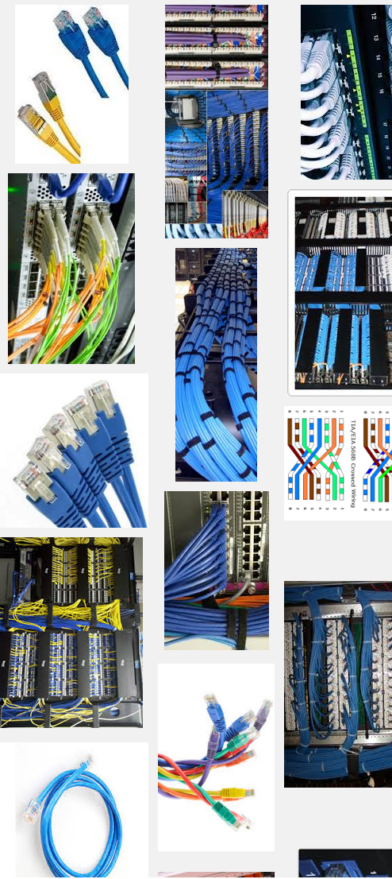
Network Cabling
Making connections with Cat6

Slide 2
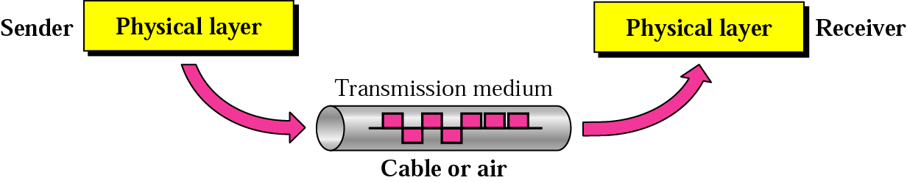
Data Transmission
Physical Media

Slide 3
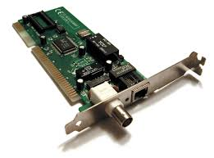
Network interface cards
Physical Media
The network interface card (NIC) provides the physical connection between the network and the computer workstation.

Slide 4
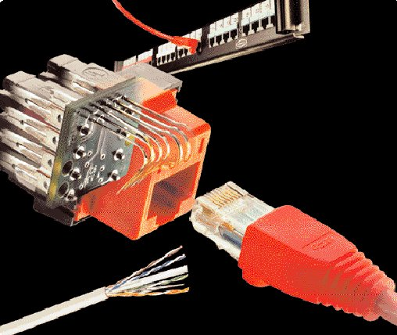
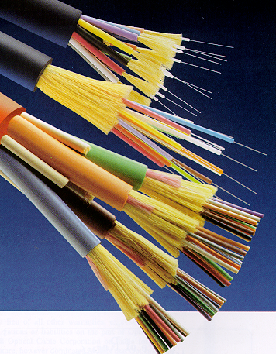
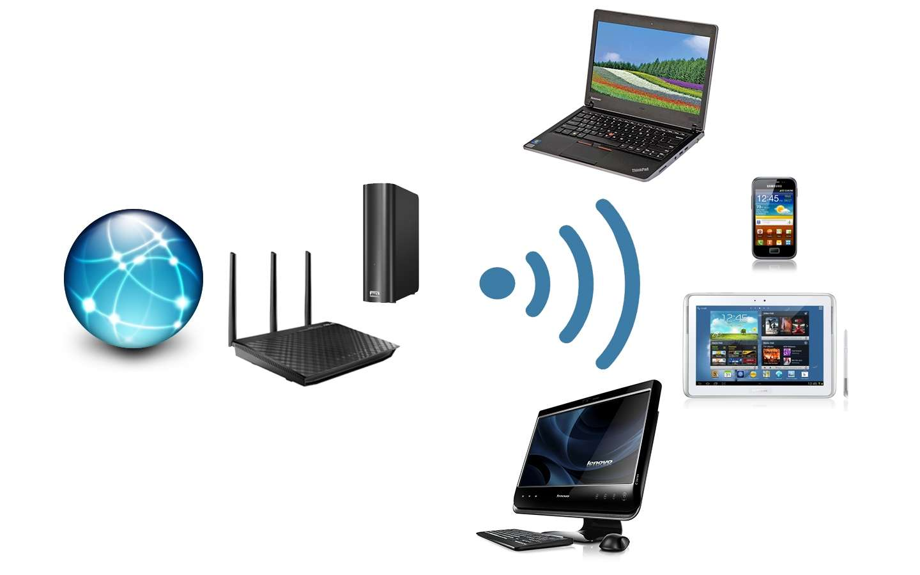
Transmission MEDIA
Physical Media

Slide 5
Media
Physical Media
Copper
  Coaxial Cable - Thick or Thin
  Unshielded Twisted Pair - CAT 3,4,5,5e&6
Optical Fiber
  Multimode
  Singlemode
Wireless
  Short Range
  Medium Range (Line of Sight)
  Satellite

Slide 6
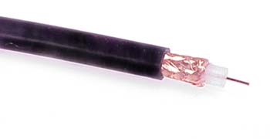
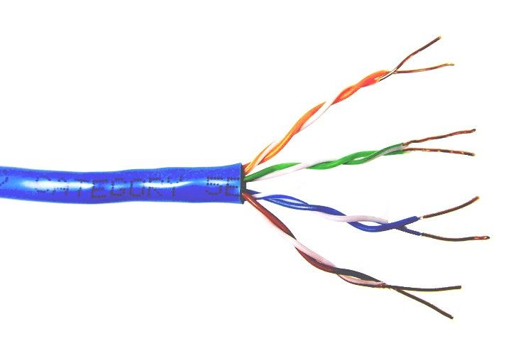
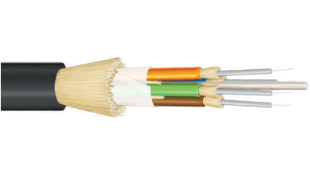
Common types of network cable used in Wired Medium
Coaxial cable
Unshielded
twisted pair
Fiber optic

Slide 7
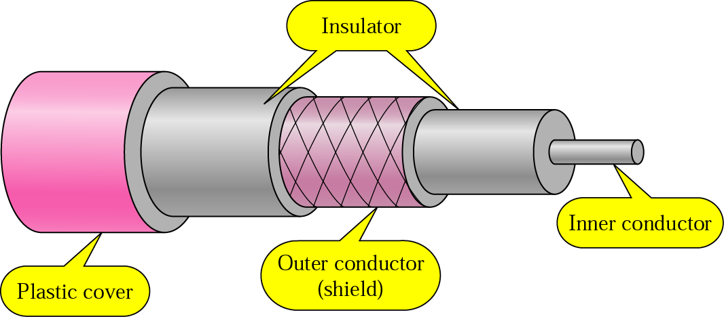
Copper Media: Coaxial Cable
Physical Media
Coaxial cable is a copper-cored cable surrounded by a heavy shielding and is used to connect computers in a network.
Outer conductor shields the inner conductor from picking up stray signal from the air.
High bandwidth but lossy channel.
Repeater is used to regenerate the weakened signals.
Category | Impedance | Use
RG-59 | 75 Ω | Cable TV
RG-58 | 50 Ω | Thin Ethernet
RG-11 | 50 Ω | Thick Ethernet

Slide 8
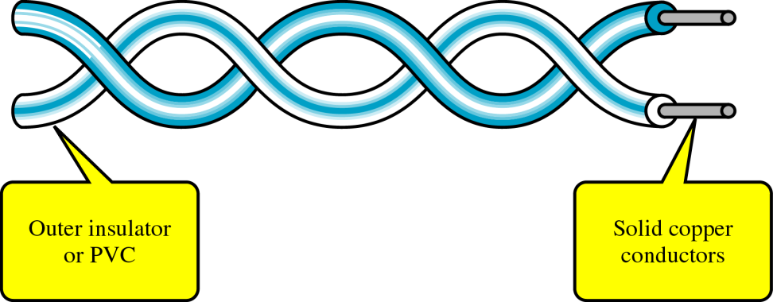
Copper Media: Twisted Pair
Physical Media
Twisted-pair is a type of cabling that is used for telephone communications and most modern Ethernet networks.
A pair of wires forms a circuit that can transmit data. The pairs are twisted to provide protection against crosstalk, the noise generated by adjacent pairs.
There are two basic types, shielded twisted-pair (STP) and unshielded twisted-pair (UTP).

Slide 9
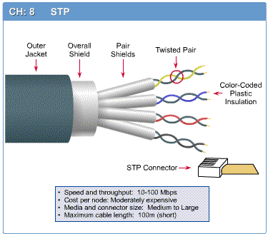
Shielded Twisted Pair (STP)
Physical Media

Slide 10
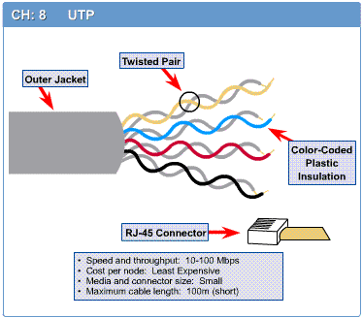
Unshielded Twisted Pair (UTP)
Physical Media

Slide 11
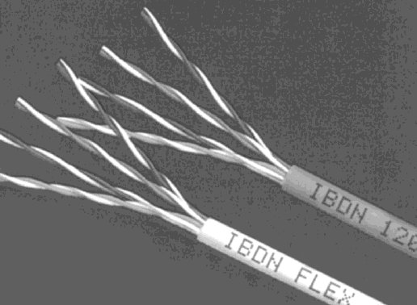
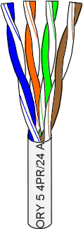
Unshielded Twisted Pair (UTP)
Physical Media
Consists of 4 pairs (8 wires) of insulated copper wires typically about 1 mm thick.
The wires are twisted together in a helical form.
Twisting reduces the interference between pairs of wires.
High bandwidth and High attenuation channel.
Flexible and cheap cable.
Category rating based on number of twists per inch and the material used
CAT 3, CAT 4, CAT 5, Enhanced CAT 5 and now CAT 6.

Slide 12
Categories of UTP
Physical Media
UTP comes in several categories that are based on the number of twists in the wires, the diameter of the wires and the material used in the wires.
Category 3 is the wiring used primarily for telephone connections.
Category 5e and Category 6 are currently the most common Ethernet cables used.

Slide 13
Categories of UTP: CAT 3
Physical Media
Bandwidth 16 Mhz
Contains 4 pairs of wires and can carry up to 10Mbps
Used in voice applications and 10baseT (10Mbps) Ethernet

Slide 14
Categories of UTP: CAT 4
Physical Media
20 MHz Bandwidth
contains 4 pairs of wires and can carry up to 16Mbps
Used in 10baseT (10Mbps) Ethernet

Slide 15
Categories of UTP: CAT 5
Physical Media
100 MHz Bandwidth
Contains 4 pairs of wires and can carry up to 100Mbps
Used in 10BaseT (10 Mbps) Ethernet & Fast Ethernet (100 Mbps)

Slide 16
Categories of UTP: CAT 5e
Physical Media
150 MHz Bandwidth
a higher grade of CAT5 that contains high-quality copper
Used in Fast Ethernet (100 Mbps), Gigabit Ethernet (1000 Mbps)

Slide 17
Categories of UTP: CAT 6
Physical Media
250 MHz Bandwidth
a twisted pair cable that contains 4 wire pairs each wrapped in foil insulation
Transmits high-speed data,
Used in Gigabit Ethernet (1000 Mbps) & 10 Gig Ethernet (10000 Mbps)

Slide 18

Fiber Media
Physical Media
Optical fibers use light to send information through the optical medium.
It uses the principal of total internal reflection.
Modulated light transmissions are used to transmit the signal.

Slide 19
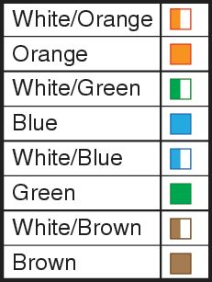
Cabling Standards
Physical Media
Cabling is an integral part of building any network.
When installing cable, it is important to follow cabling standards, which have been developed to ensure data networks operate to agreed levels of performance.
Cabling standards are a set of specifications for the installation and testing of cables.

Slide 20
Twisted Pair Cables
Physical Media
Twisted pair cable is most commonly used in network installations.
The TIA/EIA organization defines two different patterns, or wiring schemes, called T568A and T568B.
Each wiring scheme defines the pinout, or order of wire connections, on the end of the cable.
The two schemes are similar except two of the four pairs are reversed in the termination order.
TIA (Telecommunications Industry Association)
EIA (Electronics Industries Alliance).

Slide 21
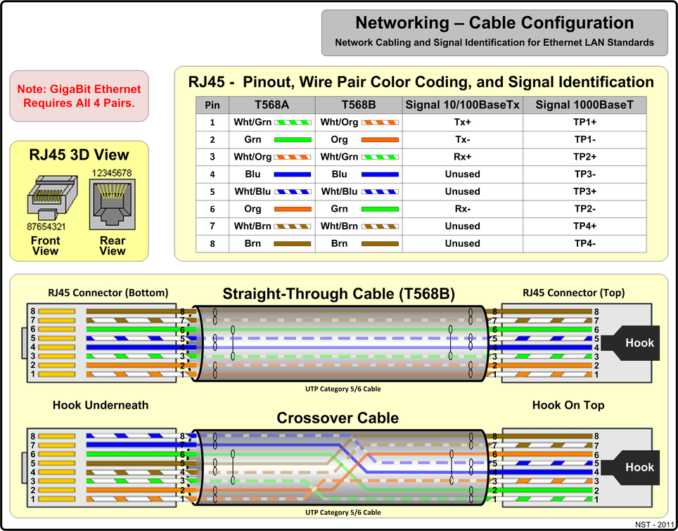
Twisted Pair Cables
Physical Media

Slide 22
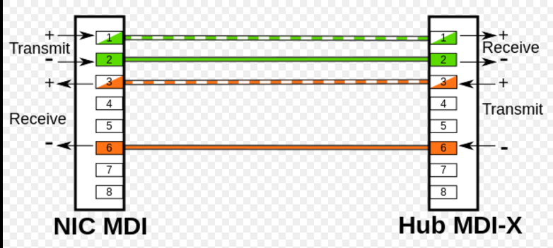

Slide 23
Twisted Pair Cables
Physical Media
On a network installation, one of the two wiring schemes (T568A or T568B) should be chosen and followed.

Slide 24
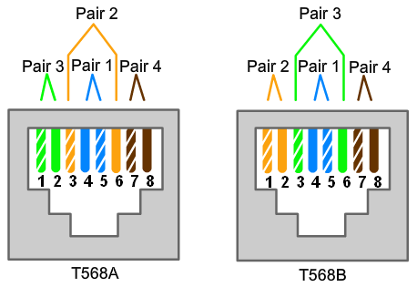
Twisted Pair Cables

Slide 25
Twisted Pair Cables
Using the T568A and T568B wiring schemes, two types of cables can be created:
  a straight-through cable
  a crossover cable.
These two types of cable are found in data installations.

Slide 26
Straight-through Cable
A Straight-through cable is the most common cable type.
It maps a wire to the same pins on both ends of the cable.
  If T568A is on one end of the cable, T568A is also on the other.
  If T568B is on one end of the cable, T568B is on the other. This means that the order of connections (the pinout) for each color is the exact same on both ends.

Slide 27
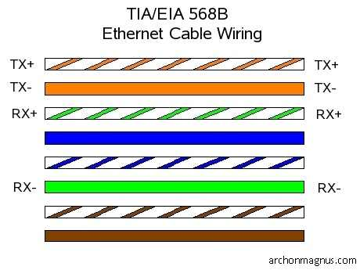
Straight-through Cable

Slide 28
Crossover Cable
A crossover cable uses both wiring schemes.
T568A on one end of the cable and T568B on the other end of the same cable. This means that the order of connection on one end of the cable does not match the order of connections on the other.
The straight-through and crossover cables each have a specific use on the network. The type of cable needed to connect two devices depends on which wire pairs the devices use to transmit and receive data.

Slide 29
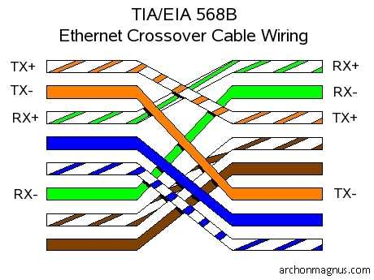
Crossover Cable

Slide 30
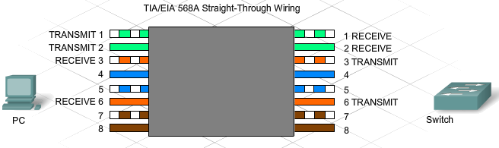
Working with Twisted-Pair Cabling
Specific pins on the connector are associated with a transmit function and a receive function. The transmit pin versus the receive pin is determined by the device being used.

Slide 31
Unlike and Like Devices
Two devices directly connected and using different pins for transmit and receive are known as unlike devices. They require a straight-through cable to exchange data.
Devices that are directly connected and use the same pins for transmit and receive, are known as like devices. They require the use of a crossover cable to exchange data.

Slide 32
Unlike and Like Devices
Examples of unlike devices that require a straight-through cable include:
  Switch port to router port
  Hub port to PC

Slide 33
Unlike and Like Devices
If a PC is directly connected to another PC (like devices), pins 1 and 2 on both devices are transmit pins and pins 3 and 6 are receive pins.
A crossover cable would ensure that the green wire connected to pins 1 and 2 (transmit pins) on one PC connect to pins 3 and 6 (receive pins) on the other PC.
If a straight-through cable were used, the wire connected to pin 1, the transmit pin, on PC1 would be connected to pin 1, the transmit pin, on PC2. It is not possible to receive data on a transmit pin.

Slide 34
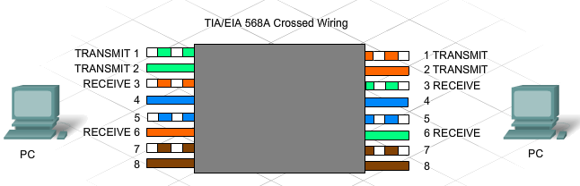
Unlike and Like Devices

Slide 35
Unlike and Like Devices
Other examples of like devices that require a crossover cable include:
  Switch port to switch port
  Switch port to hub port
  Hub port to hub port
  Router port to router port
  PC to PC
If the incorrect cable type is used, the connection between network devices will not function.
Some devices can automatically sense which pins are used for transmit and receive and will adjust their internal connections accordingly.

Slide 36
Rollover Cable
Rollover cable (also known as Cisco console cable) is a type of null-modem cable that is most commonly used to connect a computer terminal to a router's console port.
  Cisco routers and switches are normally configured over their console ports.
This cable is typically flat and the colour is also different to help distinguish it from other types of network cabling.
It gets the name rollover because the pinouts on one end are reversed from the other, as if the wire had been rolled over and you were viewing it from the other side.

Slide 37
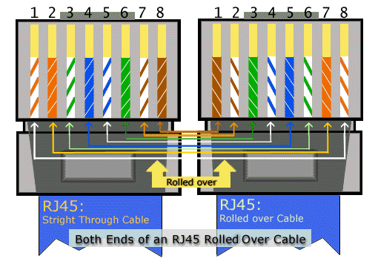
Rollover Cable

Slide 38
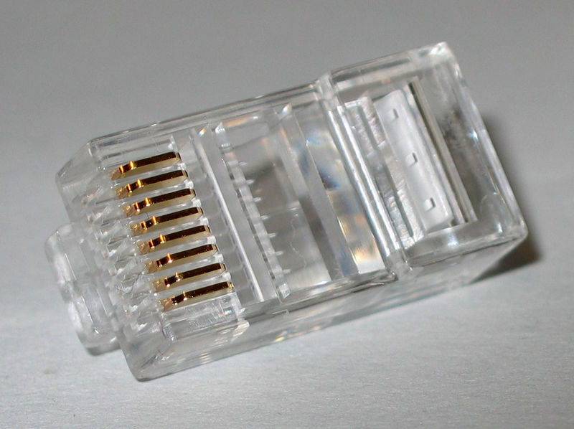
RJ45 connector

Slide 39

Making connections - Tools
Cat5e cable
RJ45 connectors
Cable stripper
Scissors
Crimping tool

Slide 40
Making connections - Steps
Strip cable end
Untwist wire ends
Arrange wires
Trim wires to size
Attach connector
Check
Crimp
Test

Slide 41
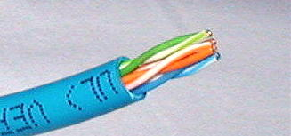
Step 1 – Strip cable end
Strip 1 – 1½” of insulating sheath
Avoid cutting into conductor insulation

Slide 42
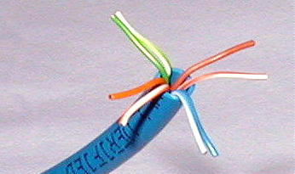
Step 2 – Untwist wire ends
Sort wires by insulation colors

Slide 43
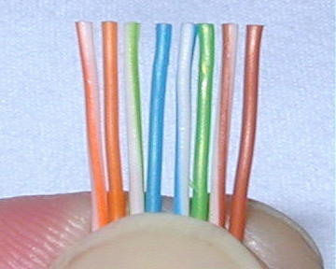
Step 3 – Arrange wires
TIA/EIA 568A: GW-G OW-Bl BlW-O BrW-Br
TIA/EIA 568B: OW-O GW-Bl BlW-G BrW-Br

Slide 44
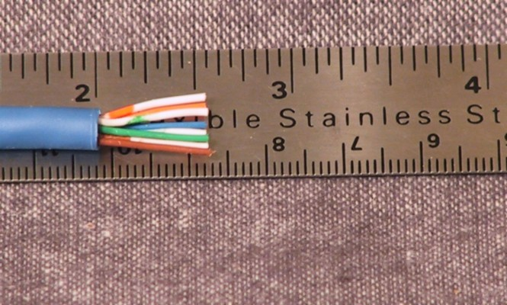
Step 4 – Trim wires to size
Trim all wires evenly
Leave about ½” of wires exposed

Slide 45
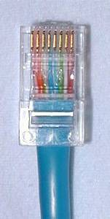
Step 5 – Attach connector
Maintain wire order, left-to-right, with RJ45 tab facing downward

Slide 46
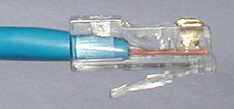
Step 6 - Check
Do all wires extend to end?
Is sheath well inside connector?

Slide 47
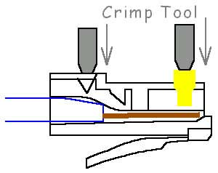
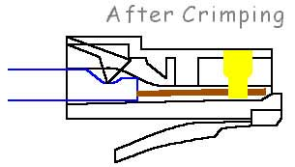
Step 7 - Crimp
Squeeze firmly to crimp connecter
onto cable end (8P)

Slide 48
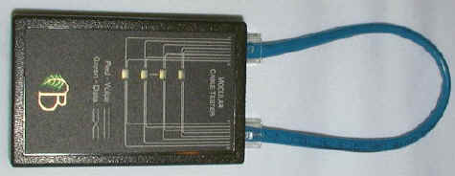
Step 8 – Test
Does the cable work?

Slide 49
Marks
10/10 = a successful cable that is prepped, crimped, and connects properly.
05/10 = a cable that does not work but is set-up reasonably well and has a detailed typed response as to possible solutions or reasons as to why the cable does not work.
0/10 = cable does not work and no explanation as to why.

Slide 50

LET’S GET STARTED!!

Slide 51

Let’s go to work!

